Slide 1
9.5 discussion
Chengxin Liao

Slide 2
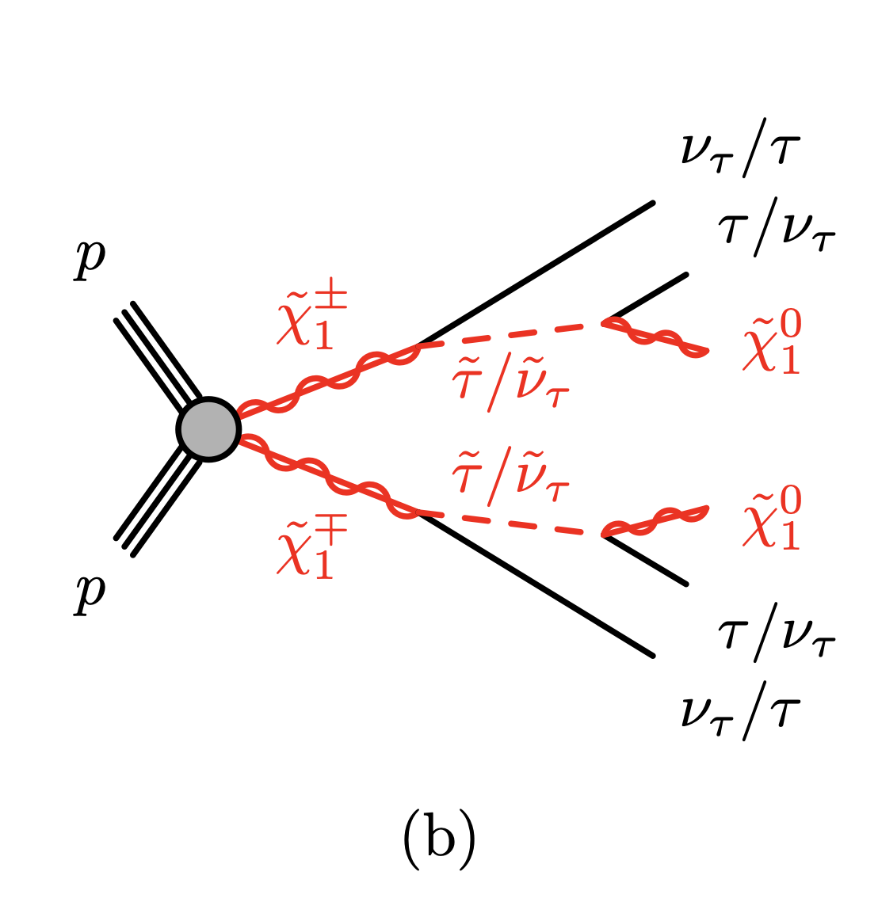
1. Summarize completed tasks
preSR cut:
Baseline, trigpass, 10GeV < MET < 150GeV, 2 medium tau, OS, b-veto
Opposite sign
No involvement of b-quark
add OS cut and b-veto cut
SR-C1C1-LM request at least a tight tau
1

Slide 3
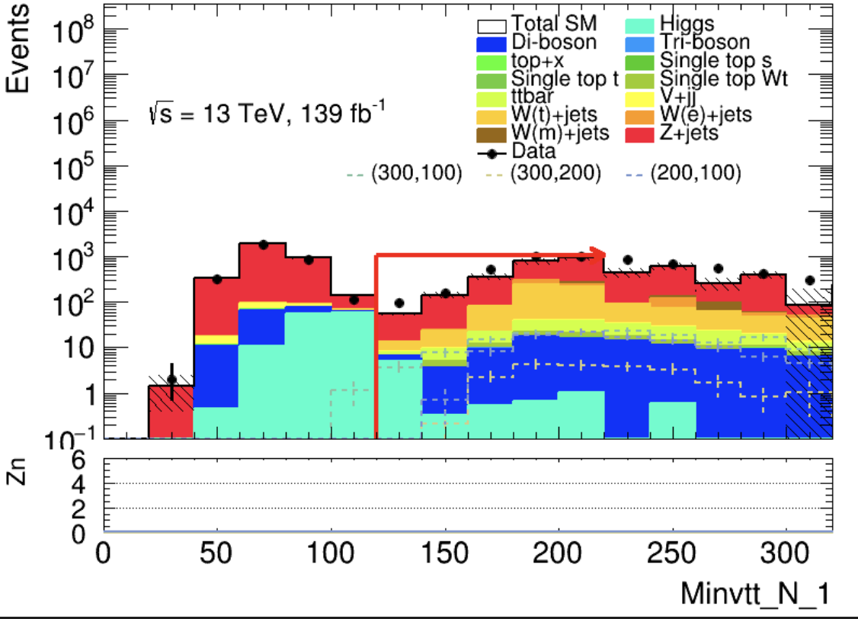
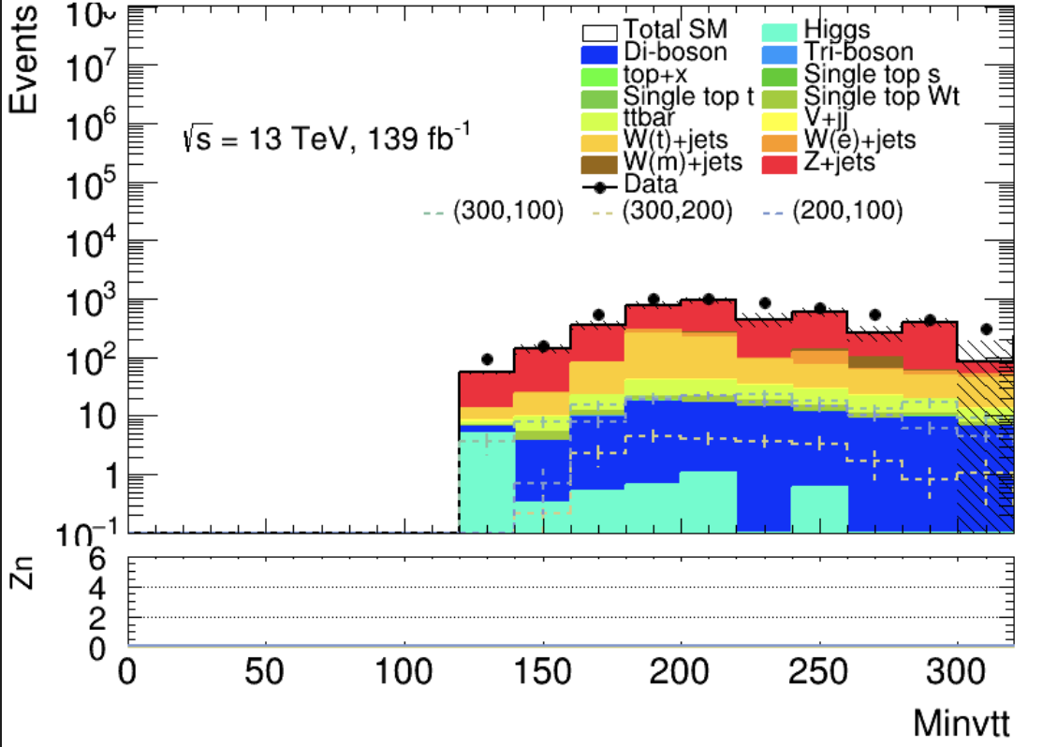

preSR cut:
Baseline, trigpass, 10GeV < MET < 150GeV, 2 medium tau, OS, b-veto
1. Summarize completed tasks
Try to add Minvtt cut to pSR : pSR + (Minvtt > 120GeV)
$$m_{higgs }=126GeV, m_{Z}=91.2 GeV$$
Shape:
Baseline, trigpass, 10GeV < MET < 150GeV, 2 medium tau
Minvtt can suppress the higgs and Z boson
2

Slide 4
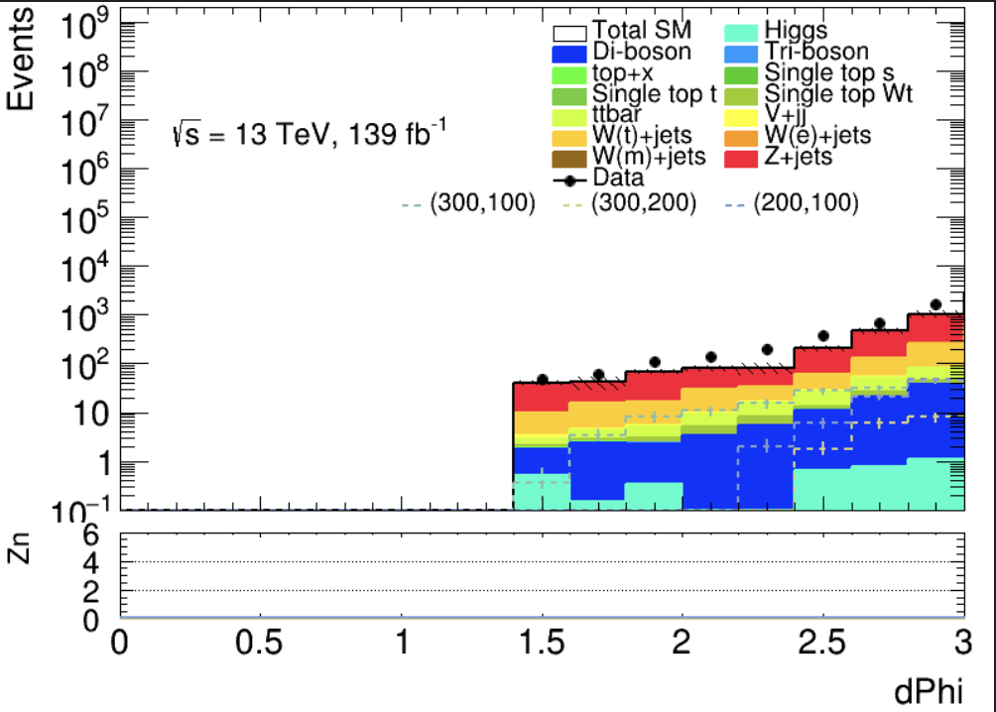
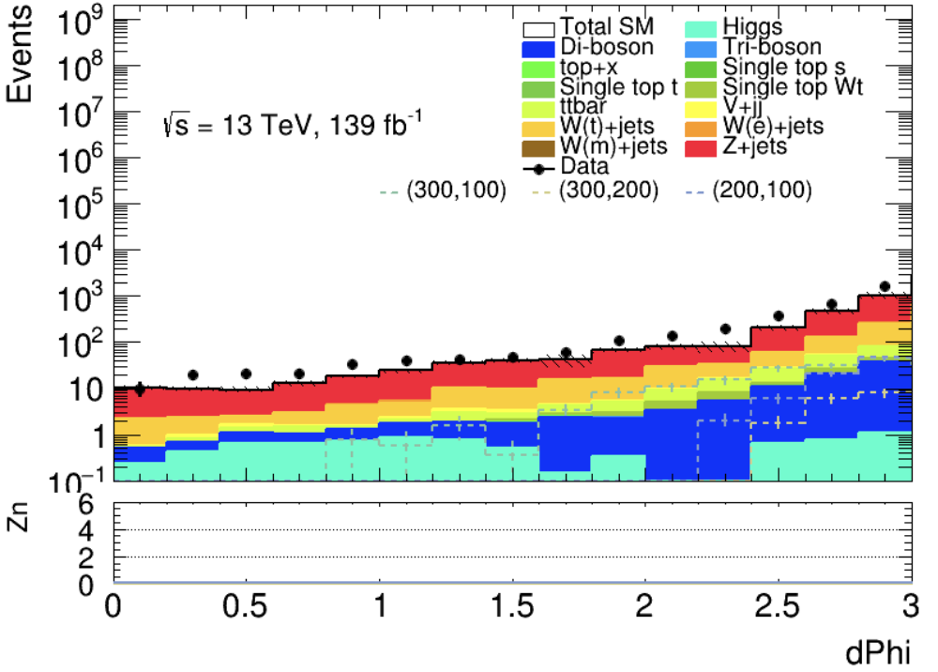
preSR cut:
Baseline, trigpass, 10GeV < MET < 150GeV, 2 medium tau, OS, b-veto
1. Summarize completed tasks
Try to add Minvtt cut to pSR : pSR + (Mintt > 120GeV) + (dphi > 1.4)
Seems there are no peak before dPhi < 1.4
dPhi suppress ?
3

Slide 5
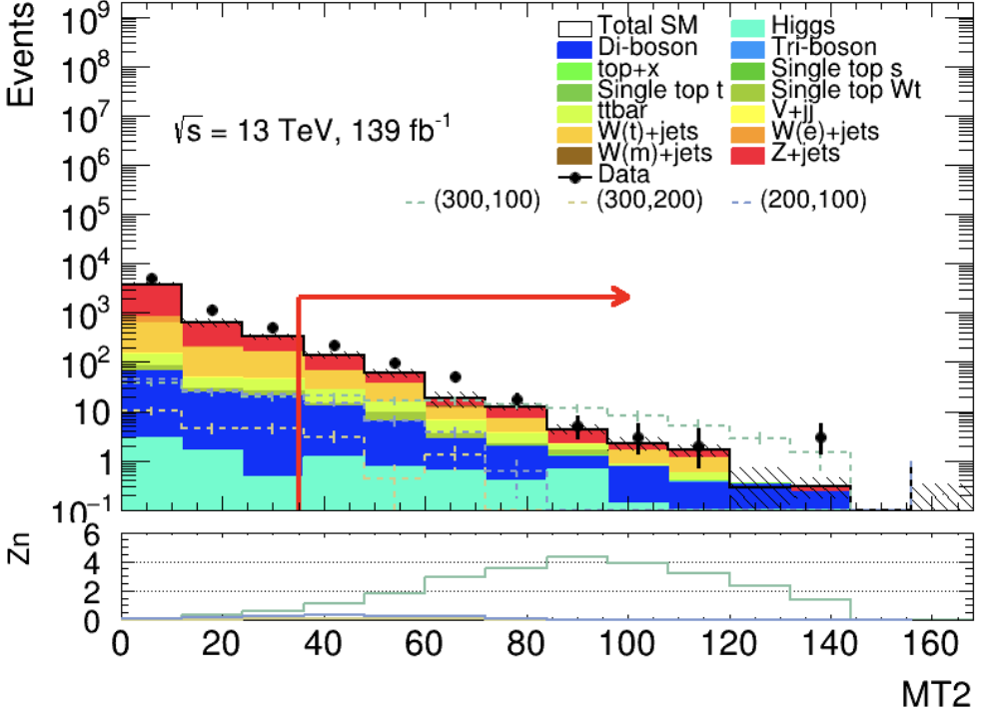
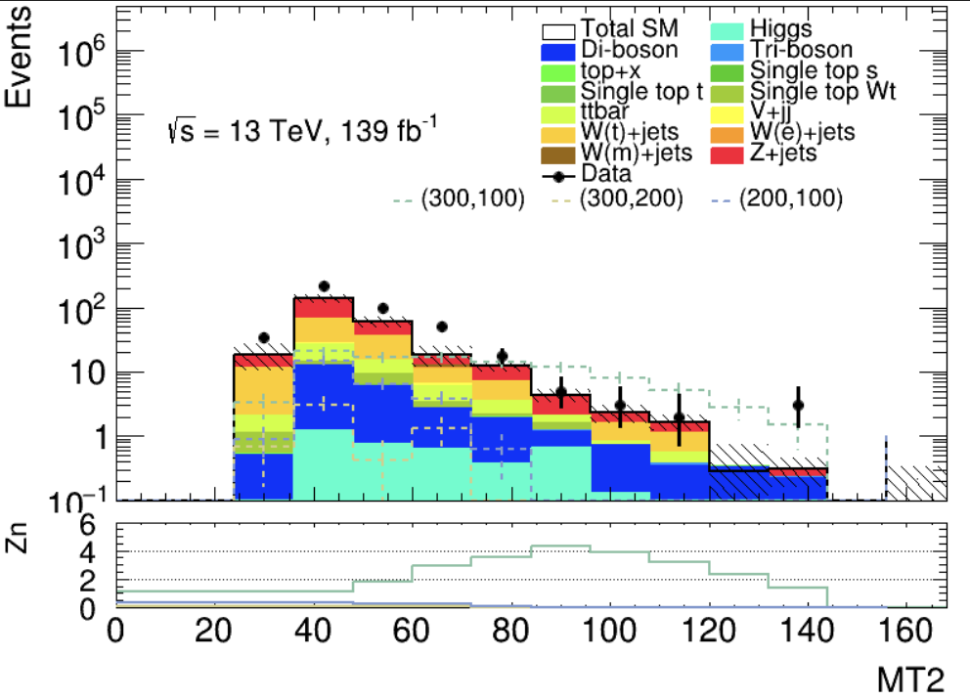
preSR cut:
Baseline, trigpass, 10GeV < MET < 150GeV, 2 medium tau, OS, b-veto
1. Summarize completed tasks
Try to add Minvtt cut to pSR : pSR + (Mintt > 120GeV) + (MT2 > 35)
figure 2 cross the line, and start from 25 ?
And figure 2 is not the same to figure 1
MT2 is a very important vars
But I don’t know how to handle it
4

Slide 6
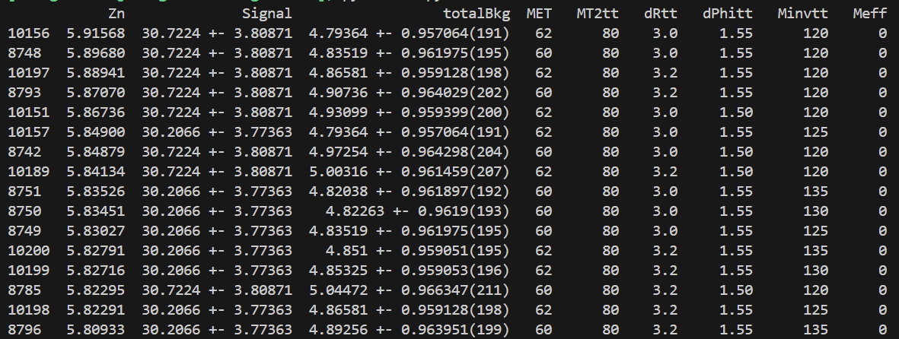
2. Define SR
Use pSR as raw data, merge them to preCUT.root
Choose a cut with a higher Zn value
But after plot some N-1 figures, cut is too tight
5

Slide 7
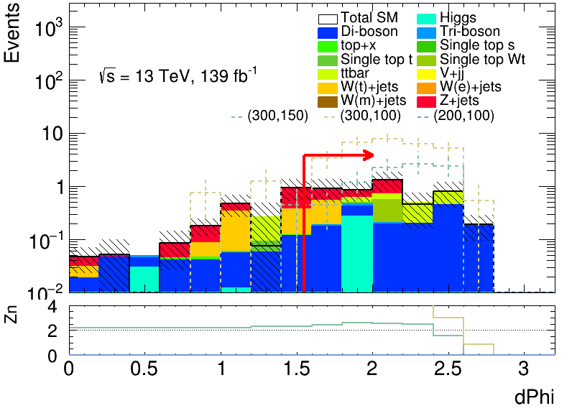
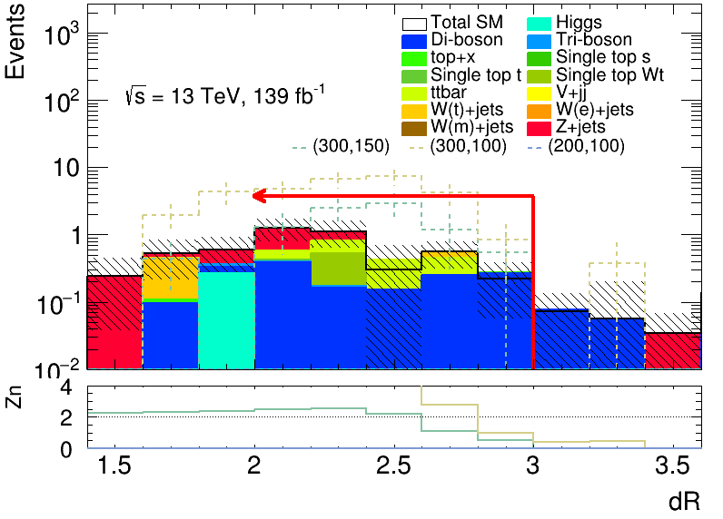
2. Define SR
B-veto | MET | Minvtt | MT2 | 2 medium tau | OS | dPhitt | dRtt | baseline | trigpass
✔️ | [60,150] | >125 | >80 | ✔️ | ✔️ | >1.55 | [0,3] | ✔️ | ✔️
6

Slide 8
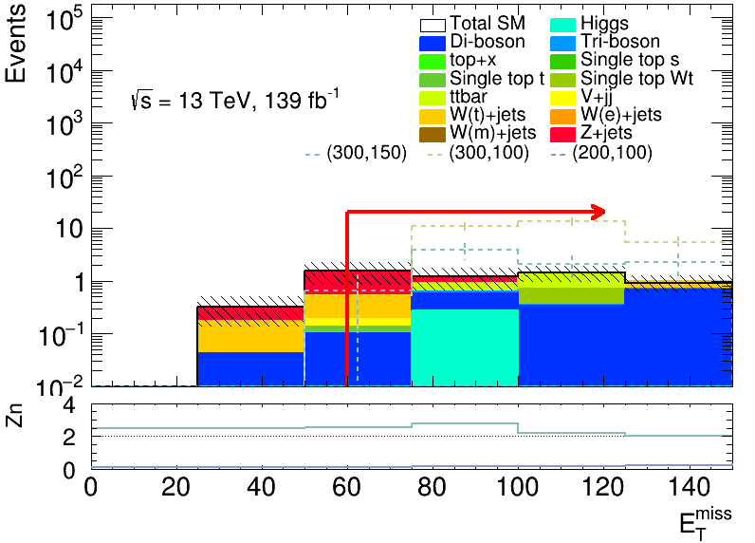
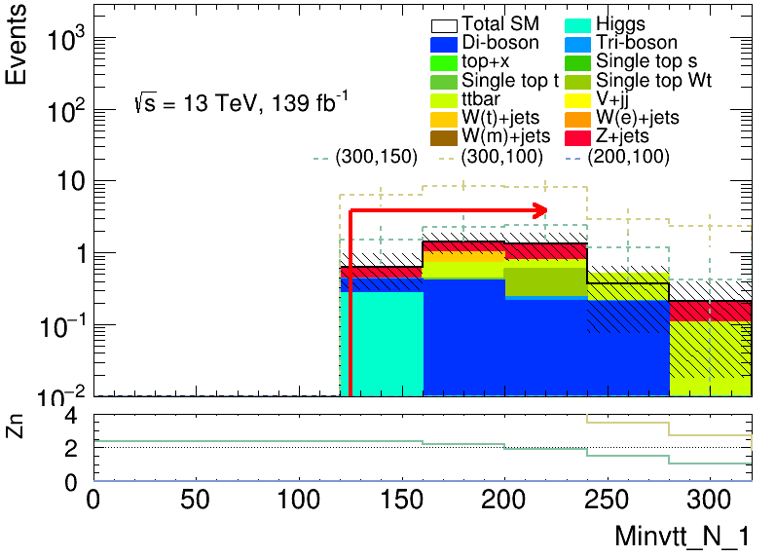
2. Define SR
B-veto | MET | Minvtt | MT2 | 2 medium tau | OS | dPhitt | dRtt | baseline | trigpass
✔️ | [60,150] | >125 | >80 | ✔️ | ✔️ | >1.55 | [0,3] | ✔️ | ✔️
7

Slide 9
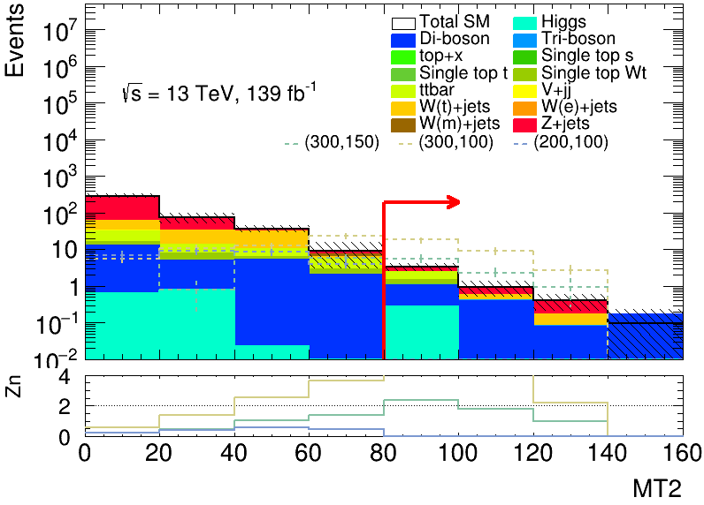
2. Define SR
B-veto | MET | Minvtt | MT2 | 2 medium tau | OS | dPhitt | dRtt | baseline | trigpass
✔️ | [60,150] | >125 | >80 | ✔️ | ✔️ | >1.55 | [0,3] | ✔️ | ✔️
8

Slide 10
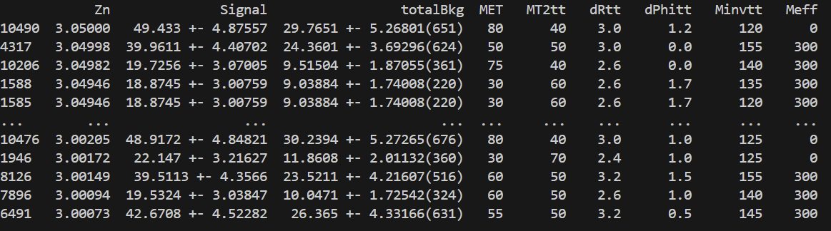
2. Define SR
Choose Zn is about 3
B-veto | MET | Minvtt | MT2 | 2 medium tau | OS | dPhitt | dRtt | baseline | trigpass
✔️ | [80,150] | >120 | >40 | ✔️ | ✔️ | >1 | [0,3] | ✔️ | ✔️
9

Slide 11
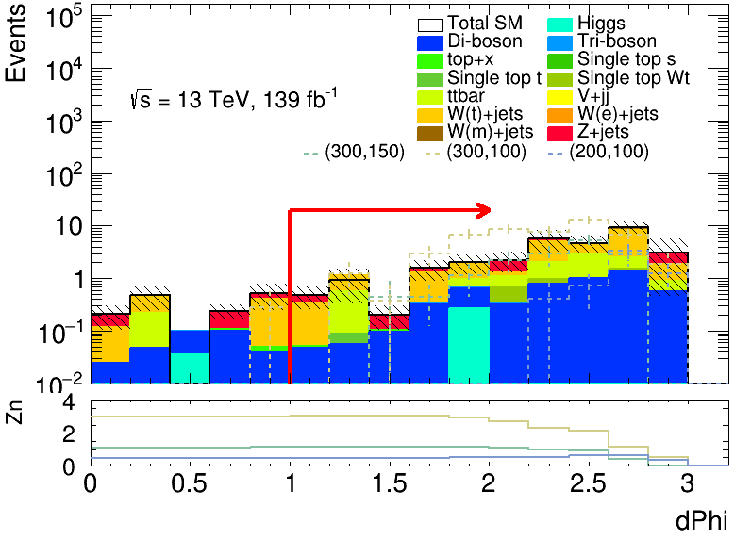
2. Define SR
B-veto | MET | Minvtt | MT2 | 2 medium tau | OS | dPhitt | dRtt | baseline | trigpass
✔️ | [80,150] | >120 | >40 | ✔️ | ✔️ | >1 | [0,3] | ✔️ | ✔️
Suppress W(t)+jets?
dPhi_N_1
10

Slide 12
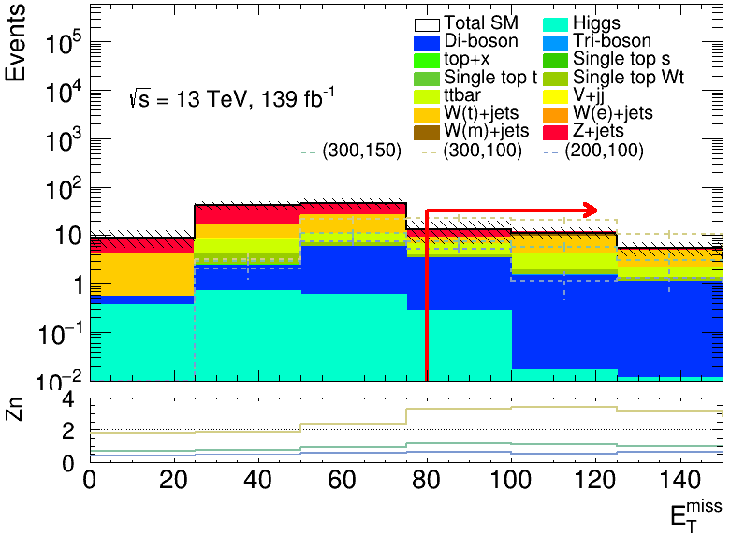
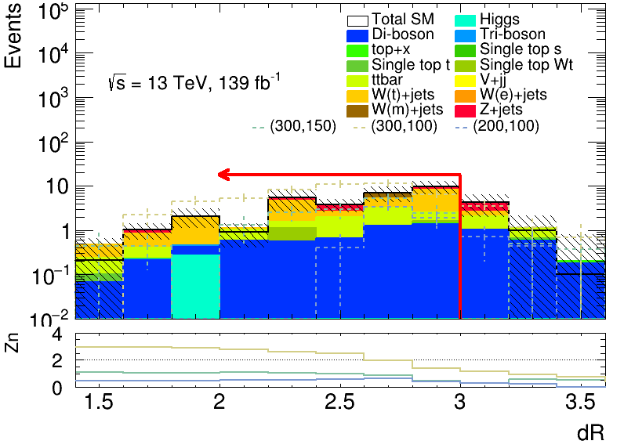
2. Define SR
B-veto | MET | Minvtt | MT2 | 2 medium tau | OS | dPhitt | dRtt | baseline | trigpass
✔️ | [80,150] | >120 | >40 | ✔️ | ✔️ | >1 | [0,3] | ✔️ | ✔️
11
dR_N_1

Slide 13
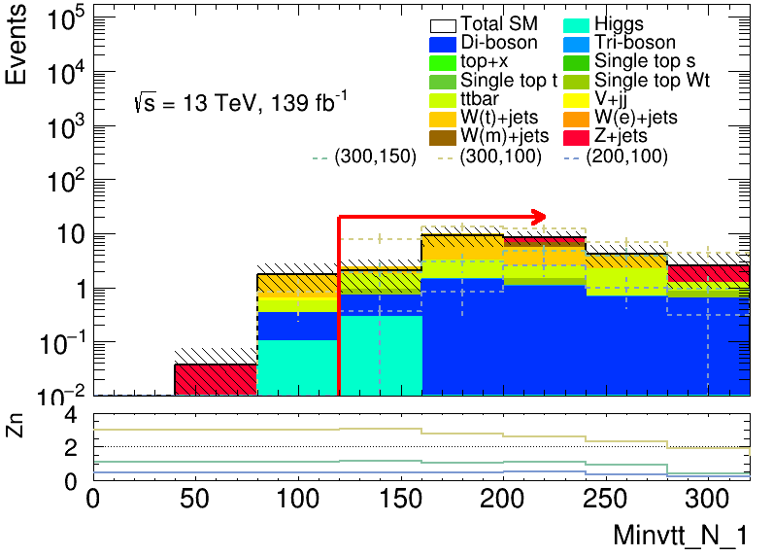
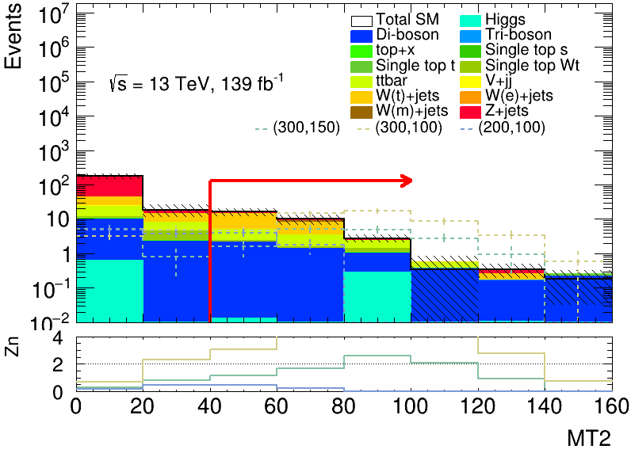
2. Define SR
B-veto | MET | Minvtt | MT2 | 2 medium tau | OS | dPhitt | dRtt | baseline | trigpass
✔️ | [80,150] | >120 | >40 | ✔️ | ✔️ | >1 | [0,3] | ✔️ | ✔️
12

Slide 14
3. Problems
How to analyze N-1 graph
How to choose the result of cut count
Shape graph ✔️
The process of cut count
13

Slide 15
4. Next step
14

